Slide 1

Project Title - Seasonal Agriculture Performance Analysis
Student Name- Srijita Ghosh
College Name- University of Engineering and Management, Kolkata
AICTE STU ID : (its available in your offer letter)

Slide 2

PROBLEM STATEMENT
Agriculture is strongly affected by seasonal changes in weather, soil conditions, water availability, farming practices and economic factors.
Because these factors change from season to season, agricultural output and financial performance may also vary.
This project aims to examine the available agricultural data and determine how farming performance differs across seasons, while identifying important trends, relationships and unusual patterns.

Slide 3
Project Description The project focuses on analysing agricultural records collected from different farming conditions and seasons. The dataset is explored to understand variations in crop production, yield, profit, irrigation, water efficiency, environmental conditions and agricultural risk. The analysis involves: • Data preprocessing and cleaning • Exploratory data analysis • Seasonal comparison • Crop and irrigation analysis • Correlation analysis • Statistical testing • Data visualization • Interpretation of results The final findings are used to suggest ways in which agricultural planning can be improved.

Slide 4

WHO ARE THE END USERS?
Farmers- Can use seasonal performance information to improve crop and resource planning.
Agricultural Managers- Can compare productivity and profitability across different farming periods.
Government & Agricultural Planners- Can use data-based findings to support seasonal agricultural strategies.
Irrigation Managers- Can examine water consumption and efficiency across irrigation methods.
Researchers & Analysts- Can use the findings as a basis for further agricultural research and predictive analysis.

Slide 5

Technology Used
Programming Language
Python
Environment
Google Colab
Libraries
• Pandas — Data manipulation and cleaning • NumPy — Numerical operations • Matplotlib — Graphs and visualizations • SciPy — Statistical analysis
Data Source
CSV agricultural dataset
Analytical Methods
• Data Cleaning • Exploratory Data Analysis • Descriptive Statistics • Correlation Analysis • Statistical Testing • Data Visualization

Slide 6
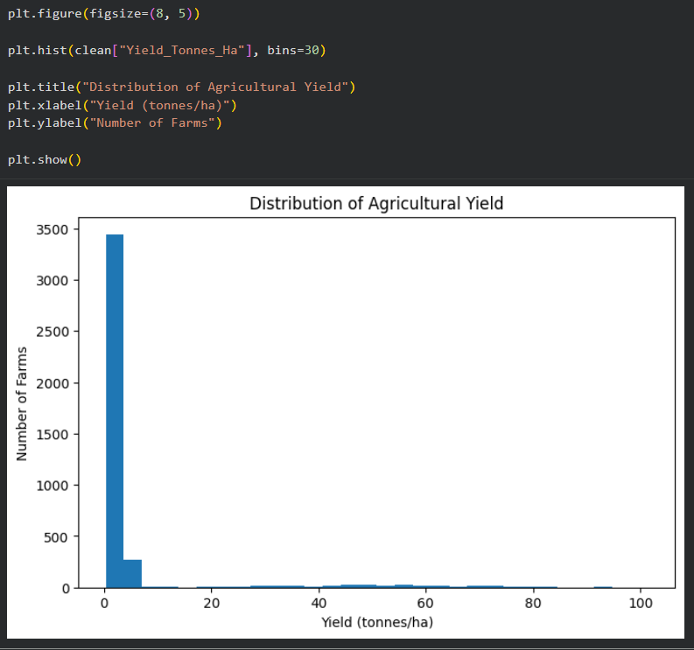
RESULTS
This histogram represents the distribution of agricultural yield across the farms. The majority of observations are concentrated at relatively lower yield values, while a smaller number of observations have much higher yields. This creates a strong right-skewed distribution with a long tail toward higher values. One possible reason is that the dataset contains different types of crops, which naturally have very different yield ranges. Therefore, these high values should be investigated rather than automatically treated as errors.

Slide 7
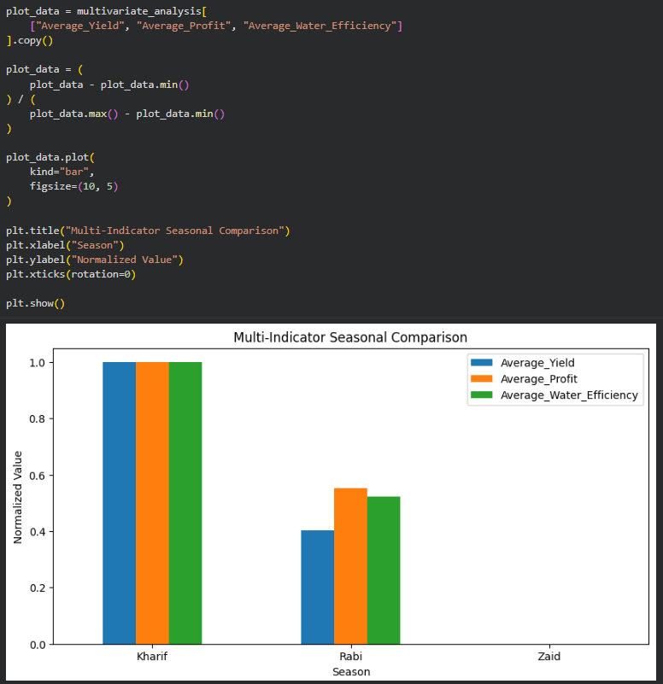
RESULTS
This is my multivariate analysis, where I am comparing three different performance indicators together: average yield, average profit and average water efficiency. Since these variables have different units and scales, I normalized their values between zero and one. Kharif reaches the highest normalized value across all three indicators, while Rabi has intermediate values. Zaid has a normalized value of zero because it has the lowest value among the three seasons for these indicators. This graph therefore shows that Kharif has the strongest overall performance across these selected indicators.The zero value for Zaid does not mean that there is no data for Zaid. It means that Zaid is the minimum reference value after normalization.

Slide 8
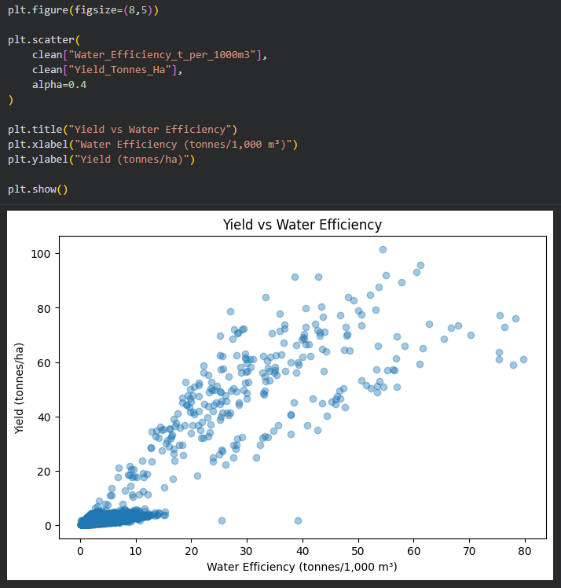
RESULTS
This scatter plot shows the relationship between water efficiency and agricultural yield. The X-axis represents water efficiency in tonnes per 1,000 cubic meters, while the Y-axis represents yield in tonnes per hectare. Each point represents an observation from the dataset. We can see an overall upward pattern, which means that higher water-efficiency values are generally associated with higher yields. Our correlation analysis gives a value of approximately 0.91, indicating a strong positive relationship. However, this is a correlation and does not mean that water efficiency alone causes higher yield, because other agricultural factors can also influence production.

Slide 9
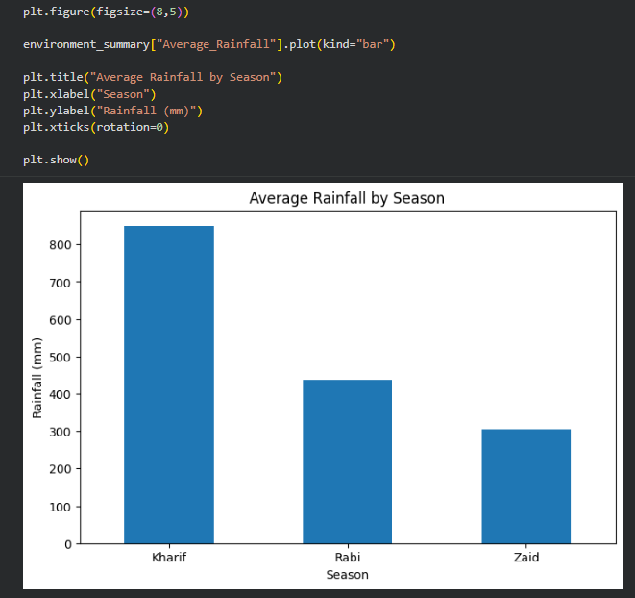
RESULTS
This graph represents the average rainfall for each season. We can see that Kharif receives the highest average rainfall, approximately 849 millimeters. Rabi receives around 438 millimeters, while Zaid receives around 305 millimeters. Therefore, there is a clear decrease in rainfall from Kharif to Zaid. This environmental difference provides useful context when comparing agricultural performance across the three seasons.

Slide 10
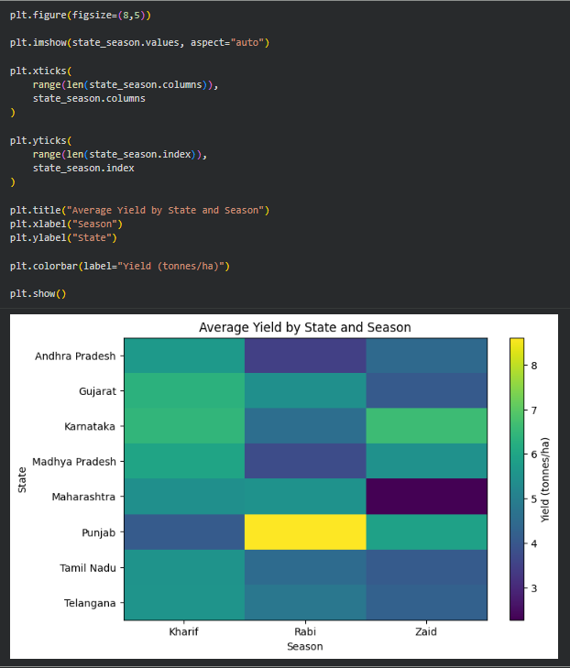
RESULTS
This heatmap shows the average yield across different states and seasons. The rows represent states and the columns represent Kharif, Rabi and Zaid seasons. The colour indicates the average yield, where yellow represents higher values and darker colours represent lower values. We can see that Punjab has the highest average yield in Rabi, at around 8.61 tonnes per hectare. Karnataka also performs very well during Zaid, at around 6.63 tonnes per hectare. On the other hand, Maharashtra has a relatively low Zaid yield of around 2.28 tonnes per hectare. Overall, this shows that seasonal agricultural performance varies from state to state, so agricultural planning should consider regional conditions.

Slide 11
Future scope • Incorporate agricultural data from multiple years to identify long-term trends. • Combine the dataset with historical weather and climate information. • Develop machine-learning models for predicting crop yield. • Build models for forecasting agricultural profitability. • Create crop-specific and region-specific recommendations. • Develop an interactive dashboard for farmers and agricultural planners. • Include future market-price information to improve profitability analysis. • Analyze fertilizer, pesticide and irrigation efficiency in greater detail.

Slide 12
GitHub Link
https://github.com/srijita2004ghosh-svg/Seasonal-Agriculture-Performance-Analysis

Slide 13
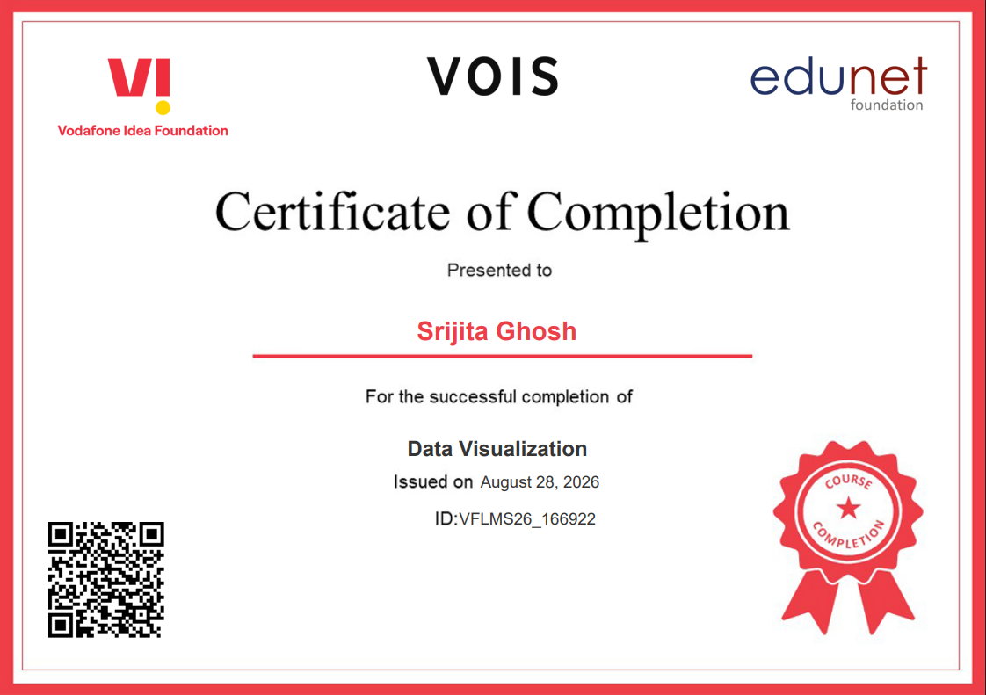
VOIS Course completion certificate - Course name- Data Visualization

Slide 14
Thank you
.
.

